Slide 1
Generative MODELS FOR SAMPLING METHODS
WORKSHOP

Slide 2
ROADMAP
PROBLEM
FORMULATION
KNOWN METHODS
CONCLUSION
MOTIVATION
OUR DATA
GFlowNet
FUTURE
WORK

Slide 3
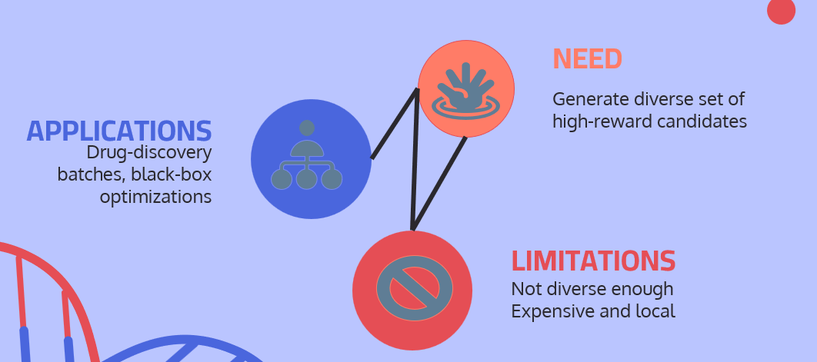


MOTIVATION
What are we looking for and why?

Slide 4
MOTIVATION
NEED
Generate diverse set of high-reward candidates
APPLICATIONS
Drug-discovery batches, black-box optimizations
LIMITATIONS
Not diverse enough Expensive and local

Slide 5
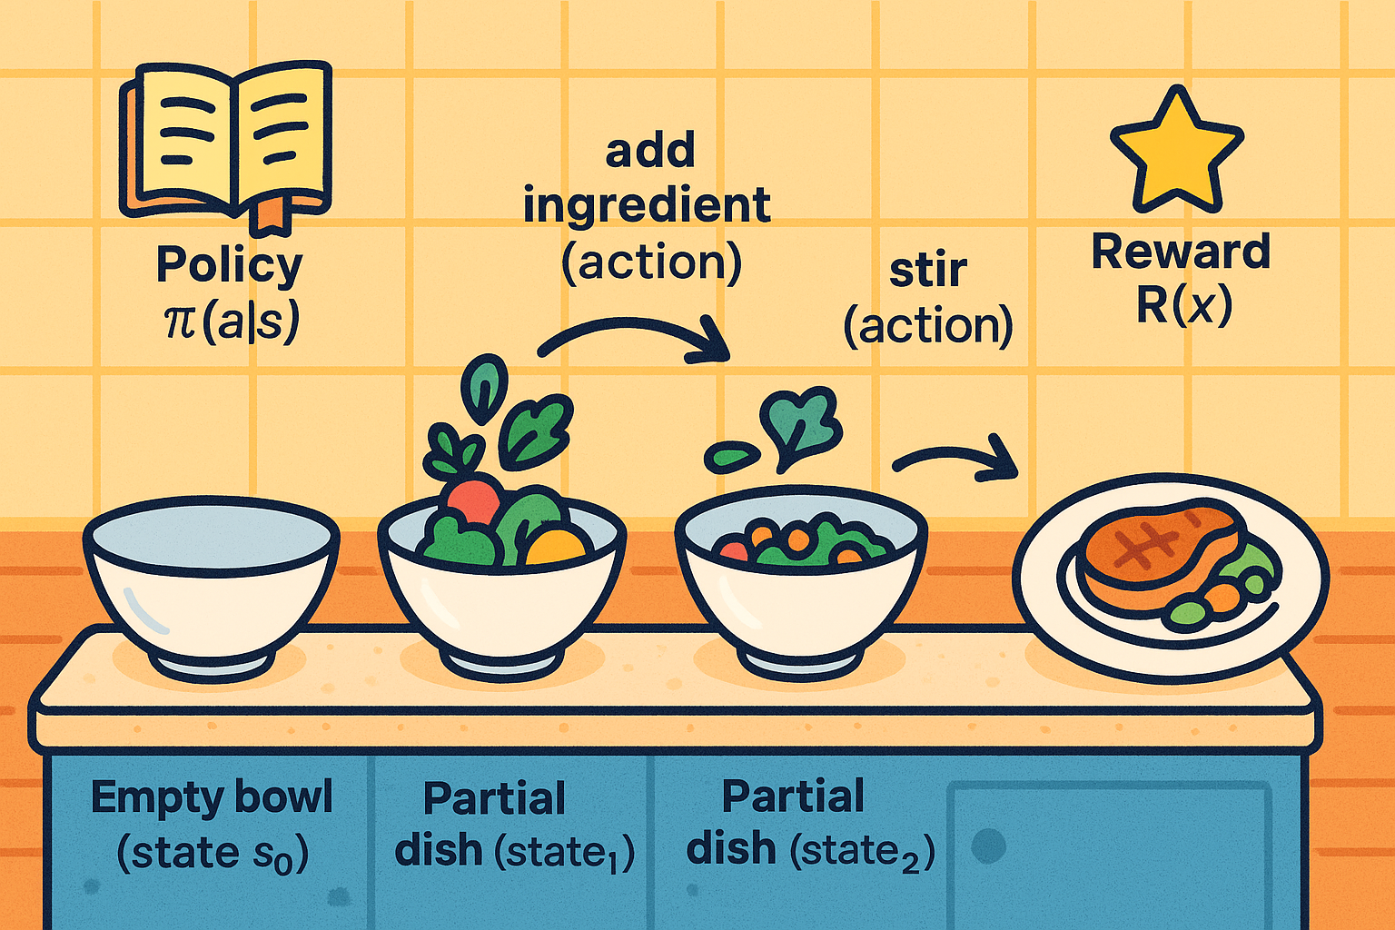
TERM DICTIONARY
$$Empty⟶add ingredient →stir ⇒trajectory$$
Notes:
Environment The kitchen itself is your “world.” You start with an empty bowl (the root state), and each time you add an ingredient or take a cooking step (an action), you move to a new partial dish (a new state). You keep cooking, step by step, until you’ve assembled a complete meal (a terminal state). Every possible way of cooking—from the order you mix ingredients to how long you let something simmer—is one unique trajectory through this kitchen world.
Policy Think of the policy as your recipe book, but one you’re still writing. For any partial dish on the stove, it tells you the probability of choosing each next cooking step (e.g. “add salt,” “stir,” “heat more,” or “add cheese”). As you learn which sequences lead to tastier meals, the recipe book gradually shifts so you’re more likely to pick steps that you know produce well-rated dishes.
Reward Only once the meal is plated and tasted (when you hit a terminal state) do you get a score—say, a customer’s rating out of 10. That score is the reward. You don’t score partial dishes mid-cooking; all the praise (or critique) comes at the end. GFlowNet’s goal is to learn to sample complete recipes in proportion to these final ratings—so a 9/10 dish should appear roughly nine times as often in your menu as a 1/10 flop.

Slide 6
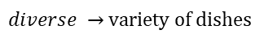
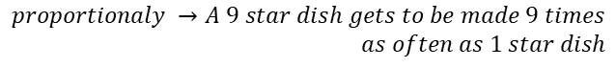
PROBLEM FORMULATION
Goal:
Generate diverse, high-quality objects
Defining a stochastic policy
Sample all promising candidates and reward
them proportionaly.
$diverse →$ variety of dishes
$stochastic policy →$ Write a probabilistic recipe book
$$proportionaly →A 9 star dish gets to be made 9 times$$
$as often as 1 star dish$

Slide 7
OUR DATA

Slide 8
KNOWN METHODS

Slide 9
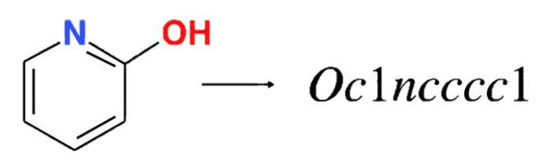
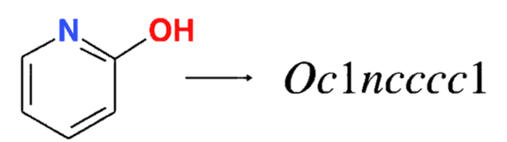
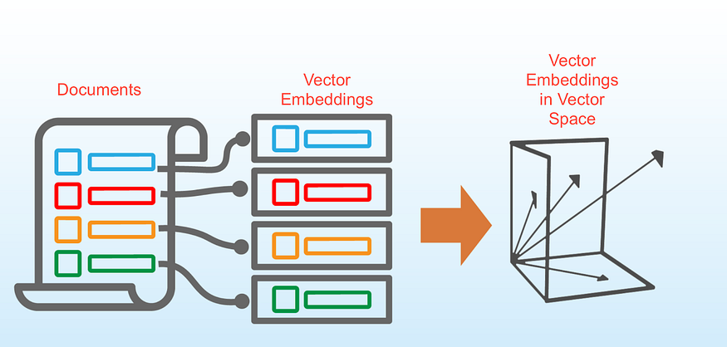
OUR DATA

Slide 10
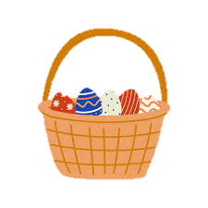
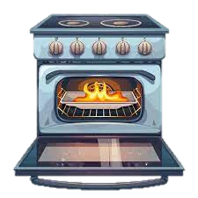
KNOWN METHODS
PPO
MCMC
Proximal Policy Optimization (PPO)
RL
Exploration vs Explotation
MARS: Markov moleculaR Sampling
Stuck in local maxima
Changes to the environment are costly

Slide 11
GFlowNet
Flow-network,Flow consistency,Policy,Learning

Slide 12
01
02
03
DISTRIBUTAION
ENVIROMENT
MARKOV DECISION PROCESS
04
05
REWARDS
WHERE
States and actions are discrete
The environment is deterministic
The MDP forms a Directed Acyclic Graph (DAG)
GFlowNet
ASSUMPTIONS
Rewards are non-negative
Rewards are only given at terminal states

Slide 13
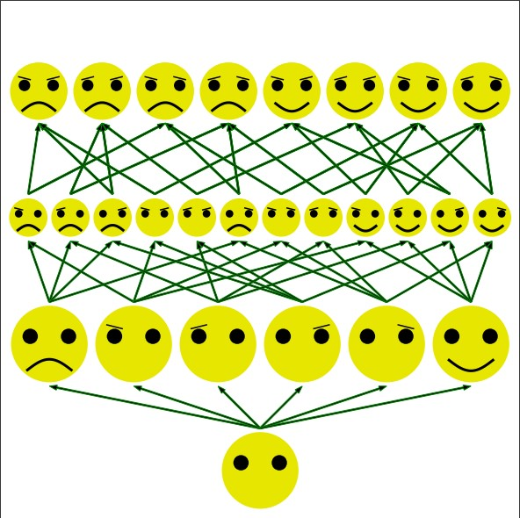

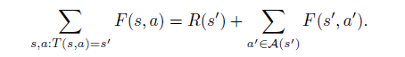
Terminal
states
Actions
States
Actions
Actions
Root state

Slide 14
CONCLUSIONS

Slide 15
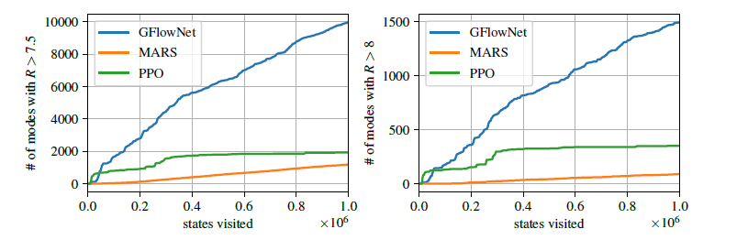
TWO CONCEPTS
REWARD and COVERAGE
Neural Network
CONCLUSIONS

Slide 16
APPLICATIONS AND FUTURE WORK

Slide 17
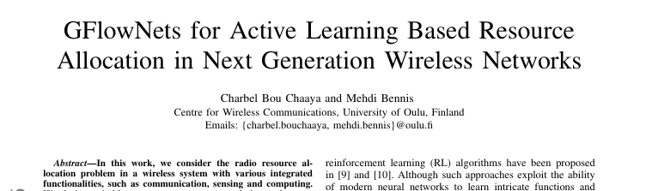
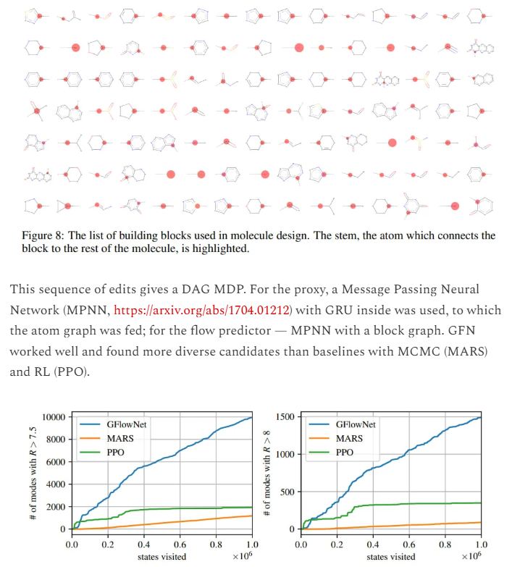
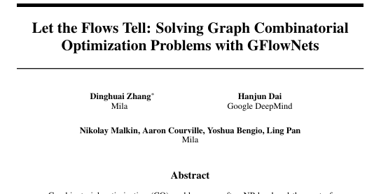
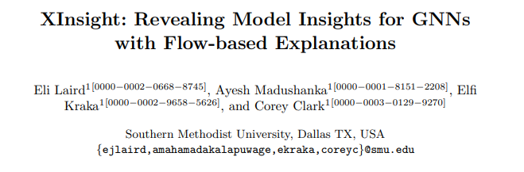
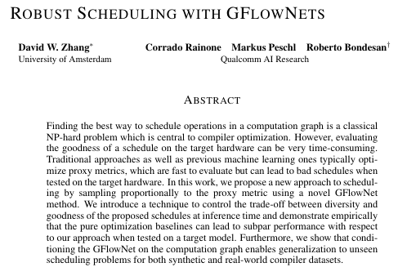
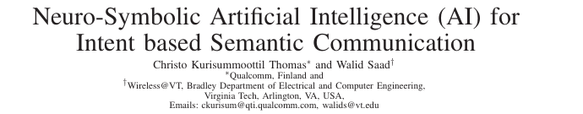

Slide 18


THANKS!

